Slide 1
CSM 32152 Management of Software Project Software Quality Assurance Lecture - 03

Slide 2
Importance of Software Quality
Increasing criticality of software
The intangibility of software
Accumulating errors during software development

Slide 3
Software Quality
Quality product is defined in terms of its fitness of purpose.
For software products, fitness of purpose is usually interpreted in terms of satisfaction of the requirements laid down in the SRS document
The traditional concept of quality as “fitness of purpose” for software products is not wholly satisfactory.

Slide 4
Software Quality
The modern view of a quality associates with a software product several quality factors such as the following:
Portability
Usability
Reusability
Correctness
Maintainability

Slide 5
Software Quality
Portability:
A software product said to be portable, if it can be easily made to work in different OS environments, in different machines, with other software products, etc.
Usability:
A software product has good usability, if different categories of users (i.e. both expert and novice users) can easily invoke the functions of the product.
Reusability:
A software product has good reusability, if different modules of the product can easily be reused to develop new products.

Slide 6
Software Quality
Correctness:
A software product is correct, if different requirements as specified in the SRS document have been correctly implemented.
Maintainability:
A software product is maintainable, if errors can be easily corrected as and when they show up, new functions can be easily added to the product, and the functionalities of the product can be easily modified, etc.

Slide 7
Software Quality Management System
A quality management system (often referred to as quality system) is the principal methodology used by organizations to ensure that the products they develop have the desired quality.
A quality system consists of the following:
Managerial Structure and Individual Responsibilities.
Quality System Activities.

Slide 8
Managerial Structure and Individual Responsibilities
A quality system is actually the responsibility of the organization as a whole.
However, every organization has a separate quality department to perform several quality system activities.
The quality system of an organization should have support of the top management.
Without support for the quality system at a high level in a company, few members of staff will take the quality system seriously.

Slide 9
Quality System Activities
Auditing of projects
Review of the quality system
Development of standards, procedures, and guidelines, etc.
Production of reports for the top management summarizing the effectiveness of the quality system in the organization.

Slide 10
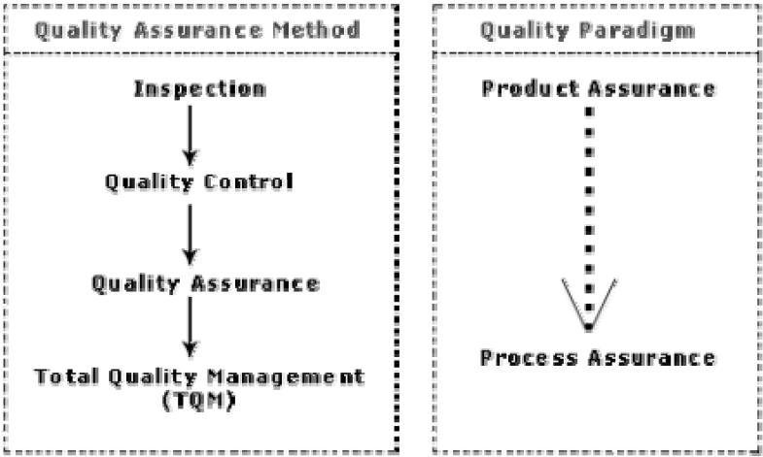
Evolution of quality management system
The usual method to produce quality products was to inspect the finished products to eliminate defective products.
Quality systems of organizations have undergone through four stages of evolution.

Slide 11
Evolution of quality management system
The initial product inspection method gave way to quality control (QC).
Quality control focuses not only on detecting the defective products and eliminating them but also on determining the causes behind the defects.
Thus, quality control aims at correcting the causes of errors and not just rejecting the products.

Slide 12
Evolution of quality management system
The next breakthrough in quality systems was the development of quality assurance principles.
The basic premise of modern quality assurance is that if an organization’s processes are good and are followed rigorously, then the products are bound to be of good quality.
The modern quality paradigm includes guidance for recognizing, defining, analyzing, and improving the production process.

Slide 13
Evolution of quality management system
Total quality management (TQM) advocates that the process followed by an organization must be continuously improved through process measurements.
TQM goes a step further than quality assurance and aims at continuous process improvement.
TQM goes beyond documenting processes to optimizing them through redesign.
A term related to TQM is Business Process Reengineering (BPR).
BPR aims at reengineering the way business is carried out in an organization.

Slide 14
Thank you

